Slide 1
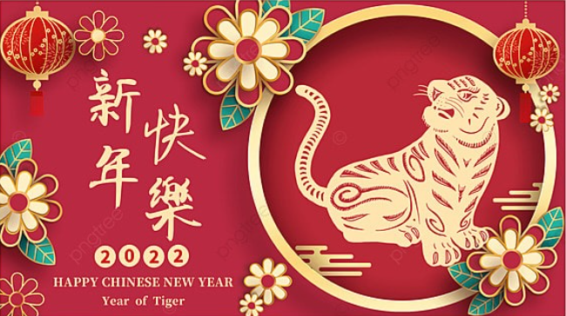
Happy Chinese New Year!
Some of our DPA families have been celebrating this week – let’s see how …

Slide 2
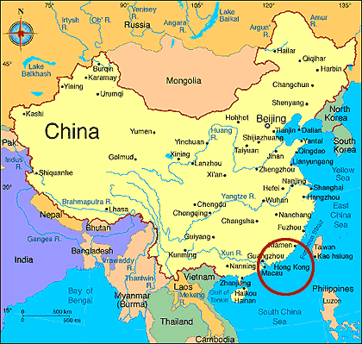
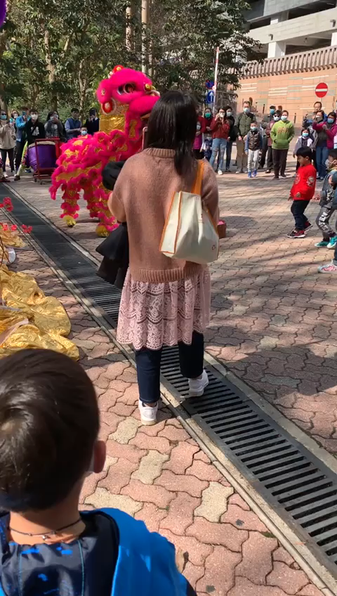
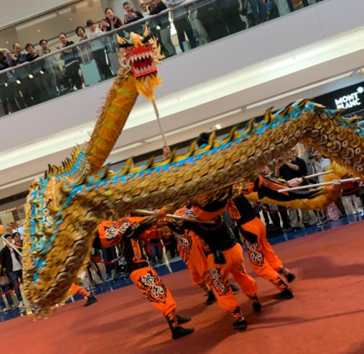
How is the New Lunar Year celebrated?
Candy says:
“We come from Hong Kong.
During Chinese New Year, there will be some performances.
The show will normally involve lion or dragon dancing/fighting on a high stage, which are representing energetic in New Year.
Watch the video!”

Slide 3
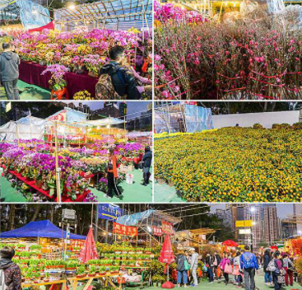
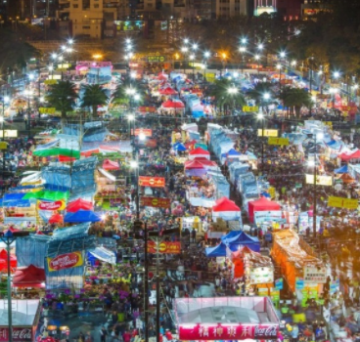
How is the New Lunar Year celebrated?
Around 20 days before New Year, the government organises a New Year Flower Market in different districts of Hong Kong, selling both dry goods and flowers.
The market last until dawn of New Year Day.
It’s a long upheld Chinese tradition to hang bright red banners with messages of good luck and fortune for the new year.
We call it “Fai Chun” in Cantonese.

Slide 4
How is the New Lunar Year celebrated?
Jason’s family says:
“During New Year we travel around Hong Kong to visit our relatives and friends, wear red jumper or traditional New Year outfit. Celebration decorations will be found everywhere.”

Slide 5
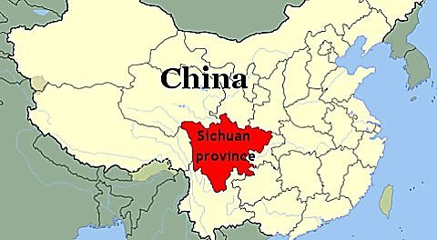
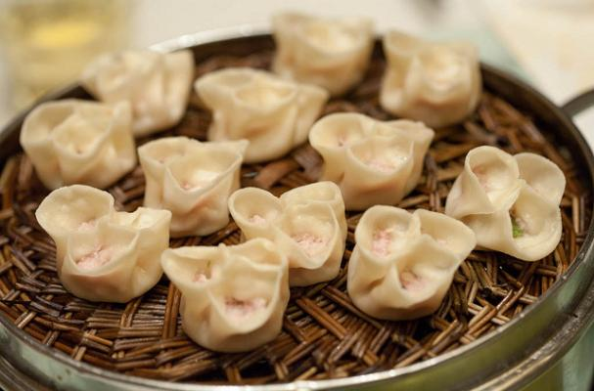
Elsie-May’s mum says:
“I am originally from South West China, Sichuan Province.
In my hometown, during Chinese New Year’s Eve, the most important thing is: family members get together and have family dinner together. This dinner can last from midday up to midnight!
We have the tradition to make lots of nice food with various types of dishes, each dish representing special meanings to bless the good fortune of the New Year. We plan to make dumplings, even though these are traditionally from Northern China.”
How is the New Lunar Year celebrated?

Slide 6
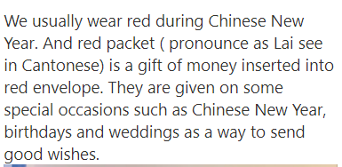
Why is the colour red important during Chinese New Year?
Jada’s mum says:
Sion’s mum, says:
“Many things are red, which represents fire. Why is that? As there’s a myth in China. In the ancient time, there was a monster called ‘year’
(年 nián). It attacks people in the village. But it’s afraid of fire. Later, people put red couplets on the door to scare the monster away. So one of the reasons we okay fireworks during new year is also because we want to scare the monsters away.”

Slide 7
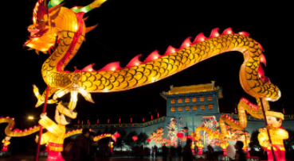
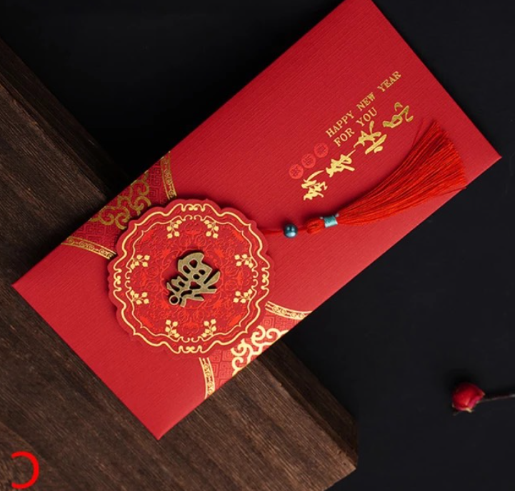
Kangrui (Ray)’s father, Cherry class, says:
“I come from Nanjing, in eastern China near Shanghai, and during Chinese new year we usually celebrated it by participating/watching traditional dragon dancing, receiving lucky money in red envelopes from elder family members (e.g., granny and grandpa), and having lots of delicious food.
Ray’s mother Alice comes from Henan Province in Northern China, and they have similar traditions to celebrate Chinese New Year, but the food are slightly different.”

Slide 8
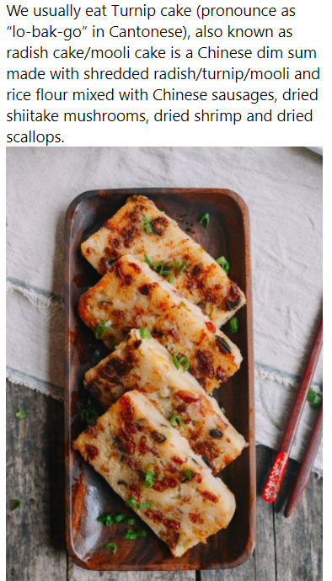
What is eaten during Chinese New Year?
Jada’s mother is from Hong Kong and her father is from England. She says:
Sion’s mum says:
“I come from Nanjing, the east part of China, near Shanghai. We don’t eat very spicy food. Our food are sweet and light.
There should always be a fish dish, which represents the wish of having sufficient food next year. It’s about the same pronunciation of the Chinese character fish 鱼 (yú) and sufficiency 余(yú).”

Slide 9
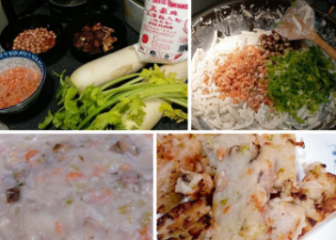
Jason’s family story, as told by his mum:
“I would like to share one of the traditional Lunar New Year food.
Traditional turnip cake is made with some valuable ingredients, like dried shrimp and smoked pork sausage, which were expensive in old days Hong Kong (60s-70s).
My grandmother was a single mum with 6 children and her life was really hard. She was so poor to buy those expensive ingredients but she wanted her children feel the happiness during this special festival, so she made a “simple version”. to made a “simple version” of turnip cake.
This very special turnip cake made the day for my mum and her bothers and was one of their very valuable childhood memories.
It became part of my childhood memories too!”

Slide 10
“Here I wish everyone at DPA a happiest Chinese New Year.
Wish every pupil grow healthily like a tiger, in the Year of Tiger.”
From Sion’s mum

