Slide 1
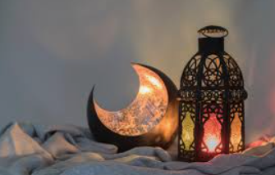
Eid Mubarak!
Some of our DPA families have
Been celebrating Eid ul Fitr!
Let’s see how …

Slide 2
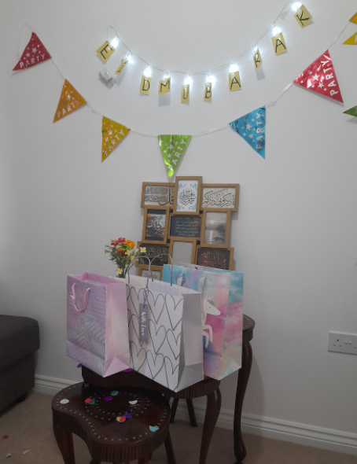
What is eid?
Eid-Ul-Fitr marks the end of the sacred month of Ramadhan for Muslims all over the world.
Eid is all about sharing and being thankful to God, and marks the end of fasting during the sacred month of Ramadan.
Ramadhan is the most important and holiest of all the holidays for Muslims and after a month of prayer, fasting, self-restraint and giving back, Eid is the time for community and celebration which reflect the core values of Islam i.e. peace, compassion and generosity.

Slide 3
What happens during eid?
We begin our Eid day early morning by offering a collective prayer at the community center or nearby mosque and share our happiness with the Muslim community by greeting everyone after the prayer.
After Eid prayers, the Eid formally begins and we wish each other
"EID MUBARIK“.
On Eid, we give gifts or money specially to children known as EIDI.

Slide 4
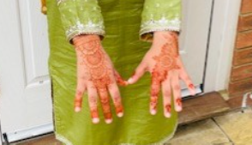
What happens during eid?
Dressing up for the prayer in clean and new clothes is practice to mark the beginning of blessings on the day. Every family pays a specific amount of money as a charity called "Fitrana" (zakat ul fitr) that goes to the needy and deprived ones to help them and to share with them the blessings.
Women and girls put Henna on their hands to celebrate Eid.
They usually do it on last day of Ramadan so they have colour on hands on Eid.

Slide 5
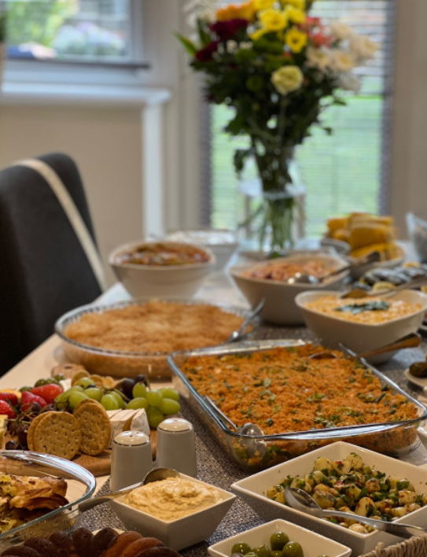
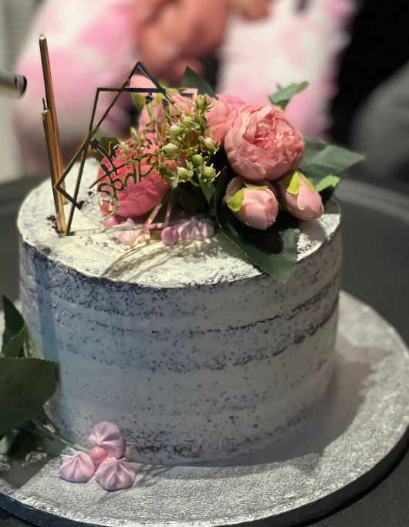
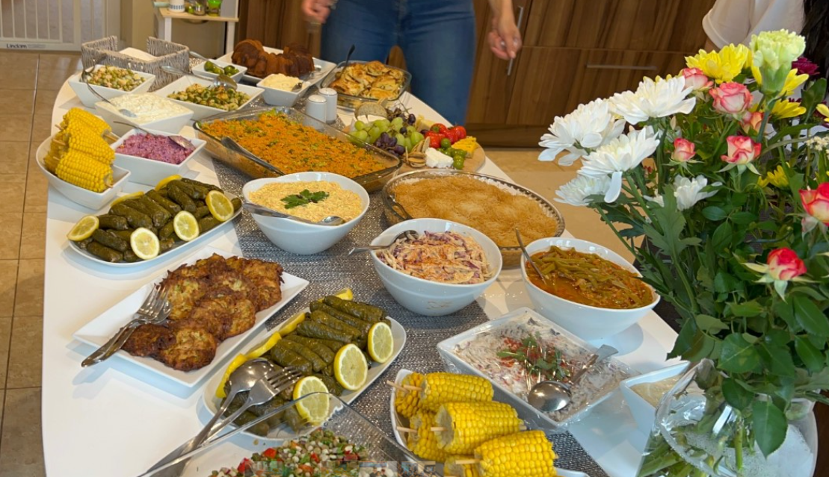
What food is eaten during eid?
Eid ul Fitr is also known as eid of sweets and we ate Sewiyaan, a traditional sweetdish with milk, Vermicelli and nuts in it.

Slide 6
What family traditions do you have?
The night before bayram (Eid) parents layout gifts and outfits for the next day. Children go to bed in new PJ’s.
On the day, everyone wears new and special clothes. Our big family gets together, everyone brings yummy food and we all talk, eat, play and have fun all day long. This time we had a special Turkish BBQ as well.
Children have to greet adults and are then presented with bayram (Eid) money.

Slide 7
Eid Mubarak to you all!
With special thanks to
Nur Burgess, Palwasha Yousaf, Anum Jawad and Anum Imrad
for your images and words!

