Slide 1
Celebrating Diversity
at Didcot Primary Academy
31st January 2022

Slide 2
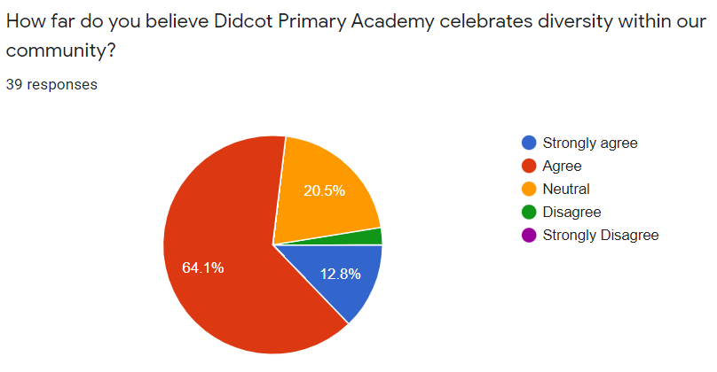
What do we mean by diversity?
The phrase "diversity" in this setting means celebrating different backgrounds, cultures and ethnicities.

Slide 3
What does our school actually look like?
Our school community is diverse
This is not reflected in the majority white workforce, therefore celebrating diversity as part of the whole curriculum is paramount

Slide 4
What are we already doing?
Jigsaw sessions support children to discuss big topics, such as discrimination
Jigsaw provide opportunities to discuss, within our classes, how different people live their day-to-day lives (i.e., cook, shop, dress)
Assemblies which focus on celebrating diversity: celebrating different languages in our community; introducing children to role models from diverse backgrounds

Slide 5
What are we already doing?
Small things can be big things: we have a zero-tolerance policy towards discrimination, dealt with quickly by appropriate members of staff
RSE images have multiple skin tones
Representations across the curriculum are diverse, from names to images (e.g. White Rose maths characters)
Events within school to raise the profile of religions and cultures, linking to topics and curriculum

Slide 6
What are our plans for the future?
Some responses highlighted a lack of communication about the cultural events we offer.
You have asked for:
more communication, more input.
In Spring 2022, we will launch a Personal Development page on website, where we will showcase the events that we do in school, including competitions linked to the Diana Award.
From late Spring 2022, our Cultural calendar be live on our website calendar.
From Spring 2022, we will involve our community to talk about and share your experiences. We would like to hear from volunteers to come into classes, or pre-record videos, to speak about cultural events and how you celebrate them. Our first opportunity for this will be Chinese New Year celebrations.
An additional Parents’ Forum in the Summer term, to give opportunities for reflection
Culture Day 2022: we will hold a fair where families would bring and share cultural music, clothing, food and stories. This will be in the summer term, and we will ask for your input at the end of the Spring term.

Slide 7
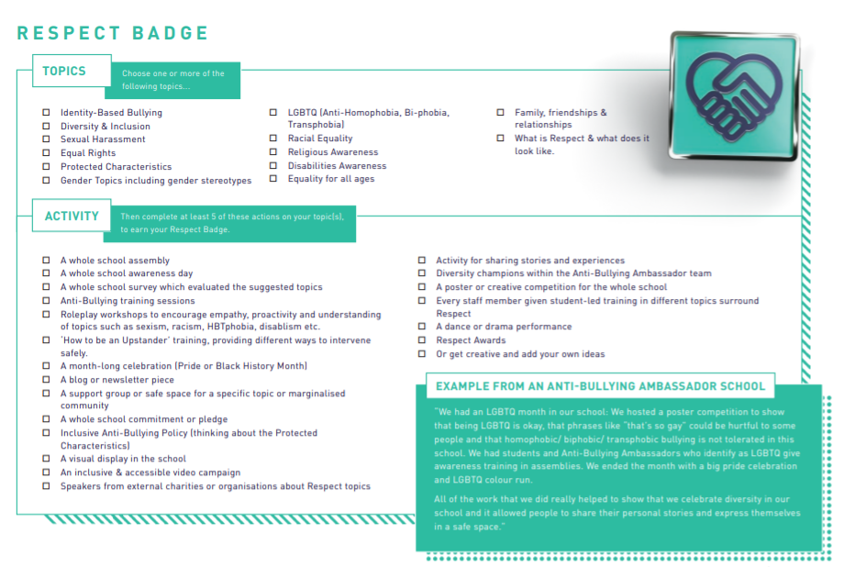
Legacy project
Diana Award: Respect
Spring and Summer 2021:
Working towards the Diana Award for Respect.
By working towards this award, the whole school will be involved in campaigns and competitions to that aim to champion diversity and inclusion, and promote equal rights.

Slide 8
Looking ahead to 2022-2023
This is an ongoing conversation
Is there anything specific that you would like us to work towards next year?
Are there any further suggestions that you would like to offer?
We are committed to representing all the families who make up our DPA community.

