Slide 1

Reading and Phonics Workshop for Parents
Thursday 18th September 2025

Slide 2
Why promote reading for pleasure?
Inspiring young people to choose to read and develop into avid readers brings many benefits.
Recent studies indicate that children who choose to read, enjoy reading and read regularly benefit in many areas:
  Academically - language acquisition, increased vocabulary, improved understanding
  Socially – understanding of people, the world, life experiences, humour
  Areas of health - including self-confidence and self esteem, understanding emotions, developing an emotional vocabulary

Slide 3
How do children become better readers?
Read Write Inc provides a systematic approach to teaching reading, the consistent and supportive approach ensures children experience success and can approach reading with confidence.
Reading to children enables children to access and experience texts that they might not choose for themselves e.g. longer books, texts with more complex sentences, a wider range of vocabulary.
Reading can be a very pleasurable shared activity, listening to stories told by a range of readers gives exposure to a range of expressive reading styles. Don’t be afraid to be adventurous with character voices, what may seem silly as an adult can really engage a young listener.

Slide 4
If you speak languages other than English then read to your child in that language too. Stories and rhymes are great in any language.
Talking about reading helps to develop comprehension and understanding. Asking open questions, helping children to make links and supporting them to understand new vocabulary really helps children to become effective readers.
Motivating reading by giving children opportunity to choose their own reading material. Joining the library can ensure free access to a wide variety of books and the opportunity to make adventurous choices, if they don’t like the book they can always choose another one.

Slide 5
The powerful impact of reading
Whether reading independently or listening to someone read, children can:
be transported to different places
form opinions
develop a sense of humour
become acquainted with people and characters and their emotions
develop empathy
explore parts of the world that they knew nothing about
develop their imagination
learn facts
make links between their own and others’ lives

Slide 6
How we can all promote a lifelong love of books and stories?
Be a role model If your child see you or other people they admire enjoying book, magazine, laughing at characters, hearing you talk about a story or a book they will be inspired to do the same.
What to read? There is a huge amount of choice and it can be overwhelming. Choice of text is very personal, some children enjoy books that make them laugh, some prefer books that make them think, some are more drawn to information books. Encourage variety but do let your child choose too. As adults we will choose a range of reading matter depending on our mood or interest.

Slide 7
Choosing a book
Consider:
The theme, does it look interesting or fun?
The length – is this a book to be read over several nights?
Are the illustrations exciting and attractive?
Will this be a story that is read repeatedly? (the sign of a good choice)
Is the story by a favourite author?
Look at the shortlists (and longlists) for children’s book awards

Slide 8
Sharing books
Make sure you are all comfortable
Try to limit distractions
Leave books around to be picked up and enjoyed at any time
Create suspense and excitement by changing your tone of voice
Create opportunities to talk about the story or text, ask those open questions
With picture books take time to explore the illustrations, they can often offer a ‘sub-plot’, this can be a valuable opportunity to create meaning and make connections for a child
As your child develops as a reader, continue to read to them throughout the primary years, it will open up a world of new adventures to you all.

Slide 9
A book at bedtime
Getting into a routine of ‘bath, book, bed’ can have great benefits for the whole family.
At the end of a busy day a warm bath, followed by a cosy story can help to create a calm atmosphere to promote sleep.
Story time can provide an opportunity for your child to talk, either about the story or it may prompt other conversations.

Slide 10
Progression through the book bands
As children progress through the book bands, the teaching focus will progress from word level reading through to comprehension, including inference and deduction
There is no set timetable of movement. This will be monitored closely by the class teacher
To be on track to achieve the expected standard at the end of Year 2 – confidently reading at a lime level
Please log your child’s reading on Boom Reader

Slide 11
Who is Read Write Inc. Phonics for?
Notes:
Read question.

Slide 12
Read Write Inc. Phonics
Nursery – Y1 (KS1)
Older children who need to‘catch-up’
Children new to English
Notes:
Using Read Write Inc. Phonics will ensure all children who come to our school learn to read:
Nursery – Y1
Older pupils who have struggled to learn to read and need to ‘catch up’,
EAL pupils
Children with SEN and dyslexia also learn to read using this programme.
Teaching and learning focuses on what children already know and what they need to learn next in order to make best possible progress - by stage not age.

Slide 13
What is Read Write Inc. Phonics?
Notes:
Read question.

Slide 14



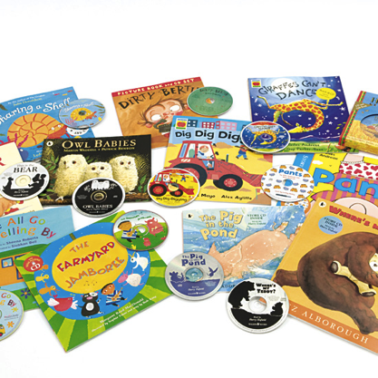




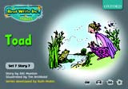
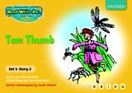

Systematic approach
sat
mat
p
d
sad
i
t
n
Notes:
Read Write Inc. Phonics is a programme that uses systematic phonics to teach all children to read.
It lasts two years for most children - if they start to learn to read in the Reception class.
(There are some children with learning difficulties who spend longer on the programme.)
Click – We teach the sounds first – in a specific order.
Click – We then teach your children to blend those sounds together in order to read words
Click – The children read words in the matched Storybooks. Each Storybook is carefully matched to the sounds they can already read - setting them up for success.
Click – We read to children ‘real’ books’. Once they have learnt to read, they will be able to independently read these books for themselves.

Slide 15
What is systematic phonics?
Notes:
Read question.

Slide 16
Phonics
Sounds
Graphemes
m a t
Notes:
The English language is very complex.
Phonics is the method of teaching reading through the identification of sounds and graphemes.
Click. All words are made up of sounds e.g. in ‘mat’ we have the sounds ‘m’, ‘a’, ‘t’.
Click A grapheme is another name for the letters we use to write the sound. Click the letters ‘m’ ‘a’ ‘t’
We teach phonics so that your children will have the tools to read any word.

Slide 17

Pure Sounds
https://www.oxfordowl.co.uk/for-home/reading-owl/find-a-book/read-write-inc-phonics--1/phonics-pure-sounds-video
Notes:
We teach using pure sounds.
We use pure sounds (‘m’ not’ muh’, ’s’ not ‘suh’, etc.) so that your child will be able to blend the sounds into words more easily.
Children need to know sounds – not letter names – to read words.
This video of Sylvie – available on the website – demonstrates how to talk in pure sounds. Play video.

Slide 18
English alphabetic code
44 sounds
Over 150+ graphemes
igh
One of the most complex alphabetic codes in the world.
Notes:
In English we have more than 150 ways to represent 44 sounds, using the 26 letters in the alphabet.
This means we have to group letters together to write some sounds. Show with a grapheme such as ‘igh’.
This makes our language one of the most complex in the world!

Slide 19
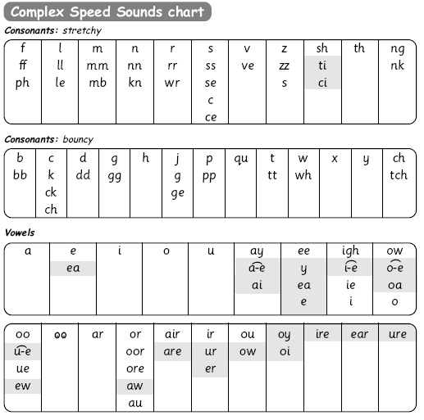
Speed Sounds chart
Notes:
We use this Speed Sounds chart in Phonics lessons.
It shows the most common graphemes for each sound.
Each box is a sound box showing different ways to read and write the sound. Demo the ‘f’ sound box with examples of words ‘fun’, ‘huff’, ‘photo’ and the ‘or’ sound box with examples of words ‘or’, ‘door’, ‘more’, ‘dawn’, ‘author’.

Slide 20
How does Read Write Inc. use phonics to teach reading?
Notes:
Read question.

Slide 21
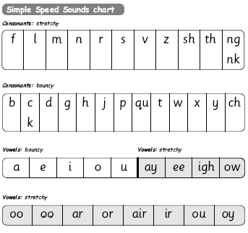
Simple Speed Sounds
Notes:
Phonics makes learning to read easy for children because we start by teaching them just one way of reading and writing every sound. Here they are on the Simple Speed Sounds chart.
We teach Set 1 sounds first - (sounds as far as a e i o u) and then Set 2 (the shaded sounds ay - oy).
Explain MTYT to parents

Slide 22
Blending using Fred Talk
p
sat
d
mat
i
t
sad
n
Notes:
Once the children know the pure sounds, we teach them to blend sounds to read words. We also teach children to spell the words they learn to read.
We use Fred Talk to help children read and spell words.

Slide 23

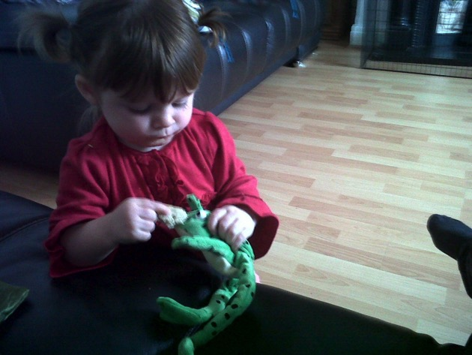
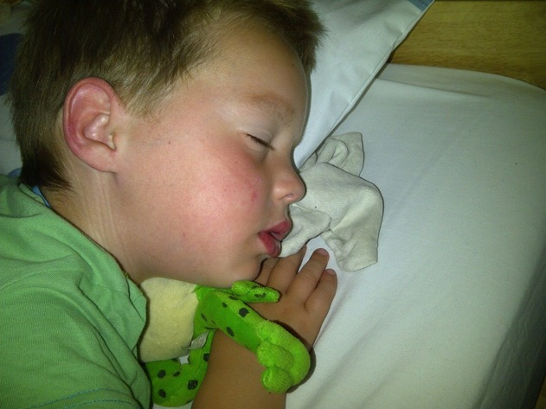
Fred Talk
Notes:
This is Fred.
He is a frog who can only speak in sounds, and we call this Fred Talk. For example ‘m’ ‘a’ ‘t’, ‘l’ ‘u’ ‘n’ ‘ch’.
He helps children sound out words so they can read and spell.
MTYT some examples with the parents. For example ‘d’ ‘o’ ‘g’ dog, ‘s’ ‘a’ ‘t’ sat.
Click. Fred is our friend!

Slide 24
Complex Speed Sounds chart
Notes:
Once they can Fred Talk and blend sounds into words from the simple chart, we teach them Set 3 sounds on the complex chart – the other ways of reading and writing each sound so that they can soon read anything.

Slide 25
Storybooks
Notes:
Alongside learning each set of sounds, they read Storybooks that only contain the sounds and words they can read. This sets them up to succeed in their reading.
We discuss and write about the ideas in these Storybooks.
We also teach children to read common exception words – words like ‘said’ and ‘they’. The children will know these as red words or tricky words.

Slide 26
How does Read Write Inc. teach spelling?
Notes:
Read question.

Slide 27

Fred Fingers
Notes:
We use Fred Fingers to help children sound out words to spell easily.
It means they do not have to memorise lists of spelling words.
It is a tool so they will be able to spell any word.
Demonstrate how to use Fred Fingers.

Slide 28
What should my child read at home?
Notes:
Read question.

Slide 29
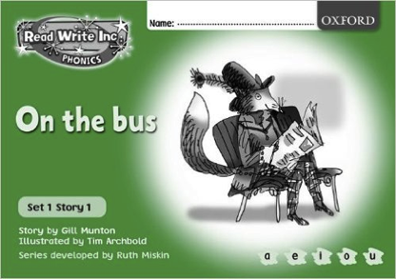
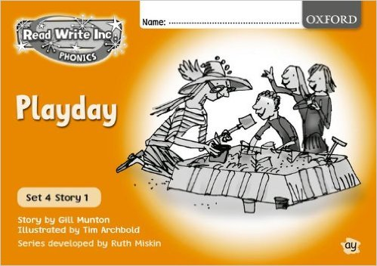
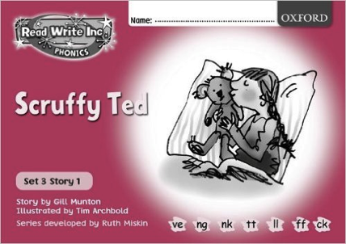
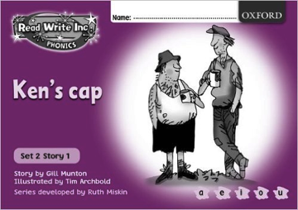


Read Write Inc. Storybooks
Notes:
ORT books
Small books with a single word per page.
We try hard to ensure that books sent home match needs to ensure success.
In school the children will be reading daily during their phonics sessions. The texts will be read to them and then read by the children over a number of days. Each session is carefully scaffolded to ensure that when the children read the text themselves they are set up for success.

Slide 30
How can I help at home?
Notes:
Read question.

Slide 31
Any questions?
Notes:
Read question.

